Slide 1
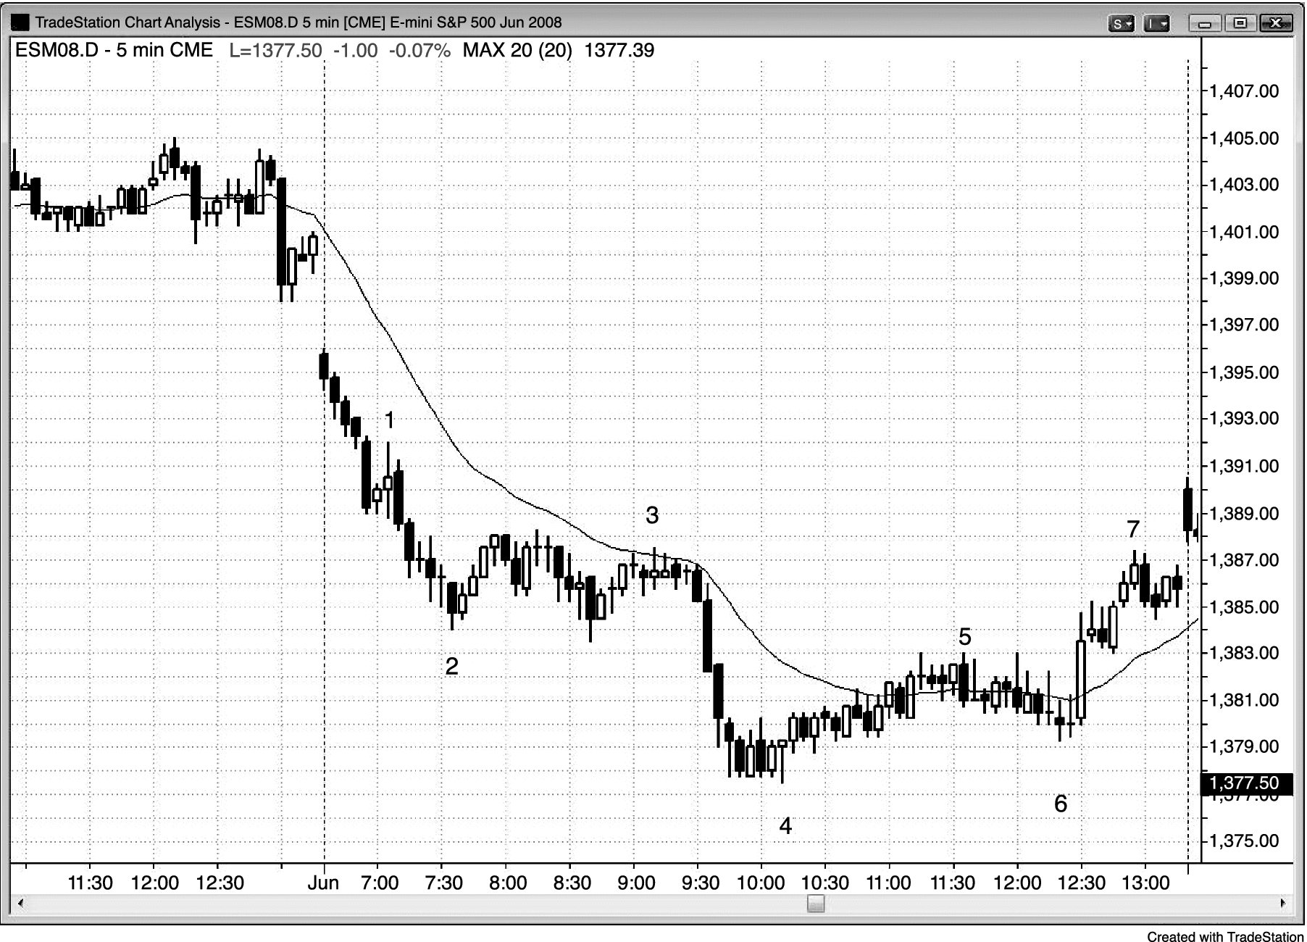
FIGURE 7.1 Outside Bars Are Tricky

Slide 2
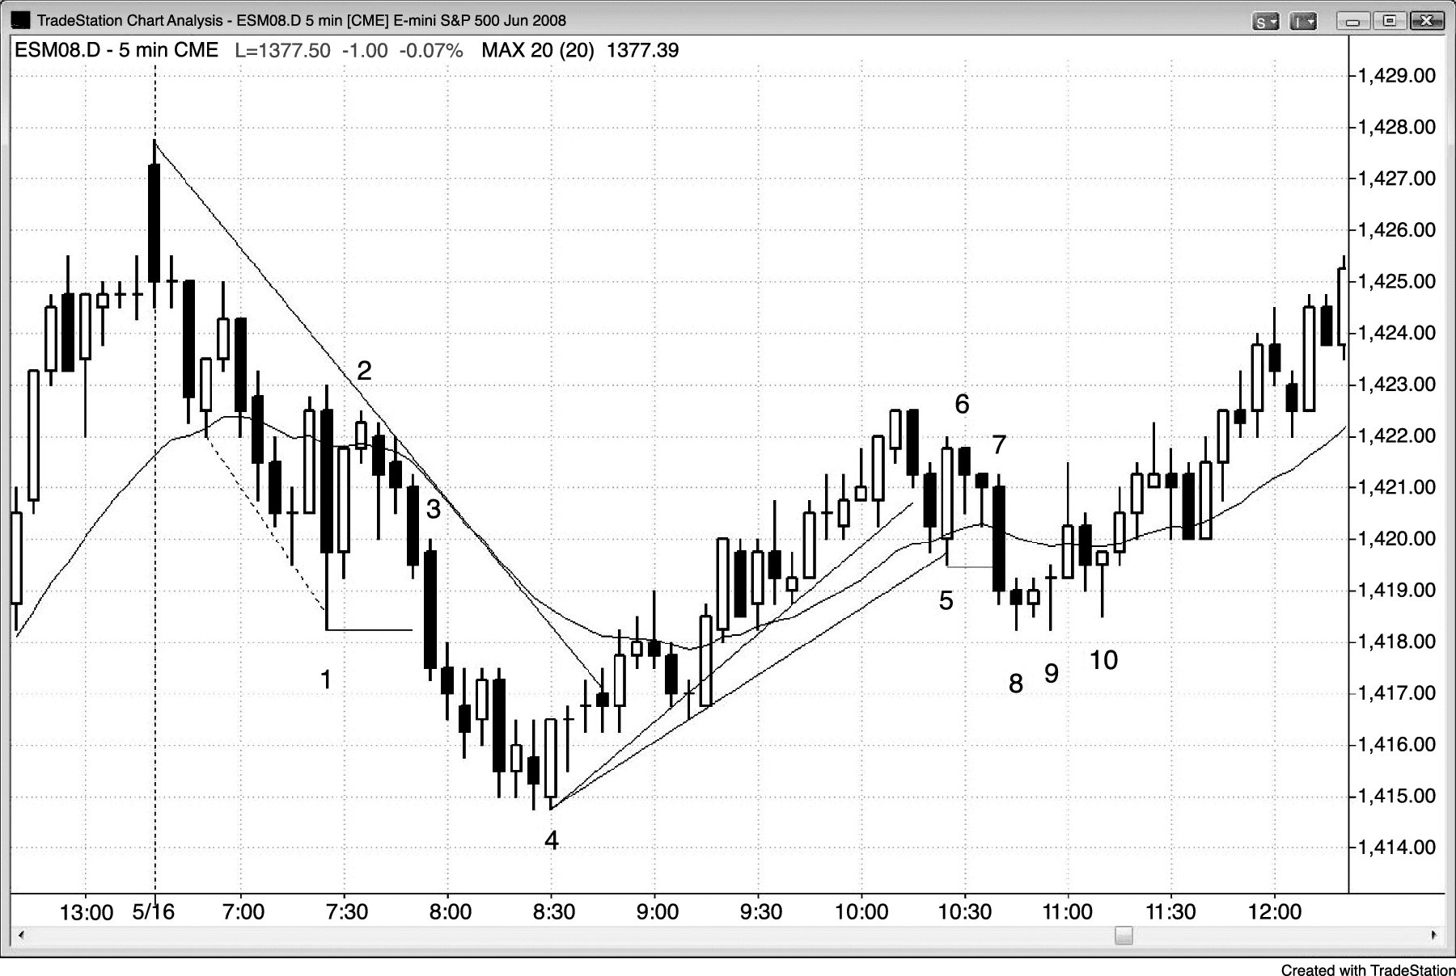
FIGURE 7.2 An ioi Pattern

Slide 3
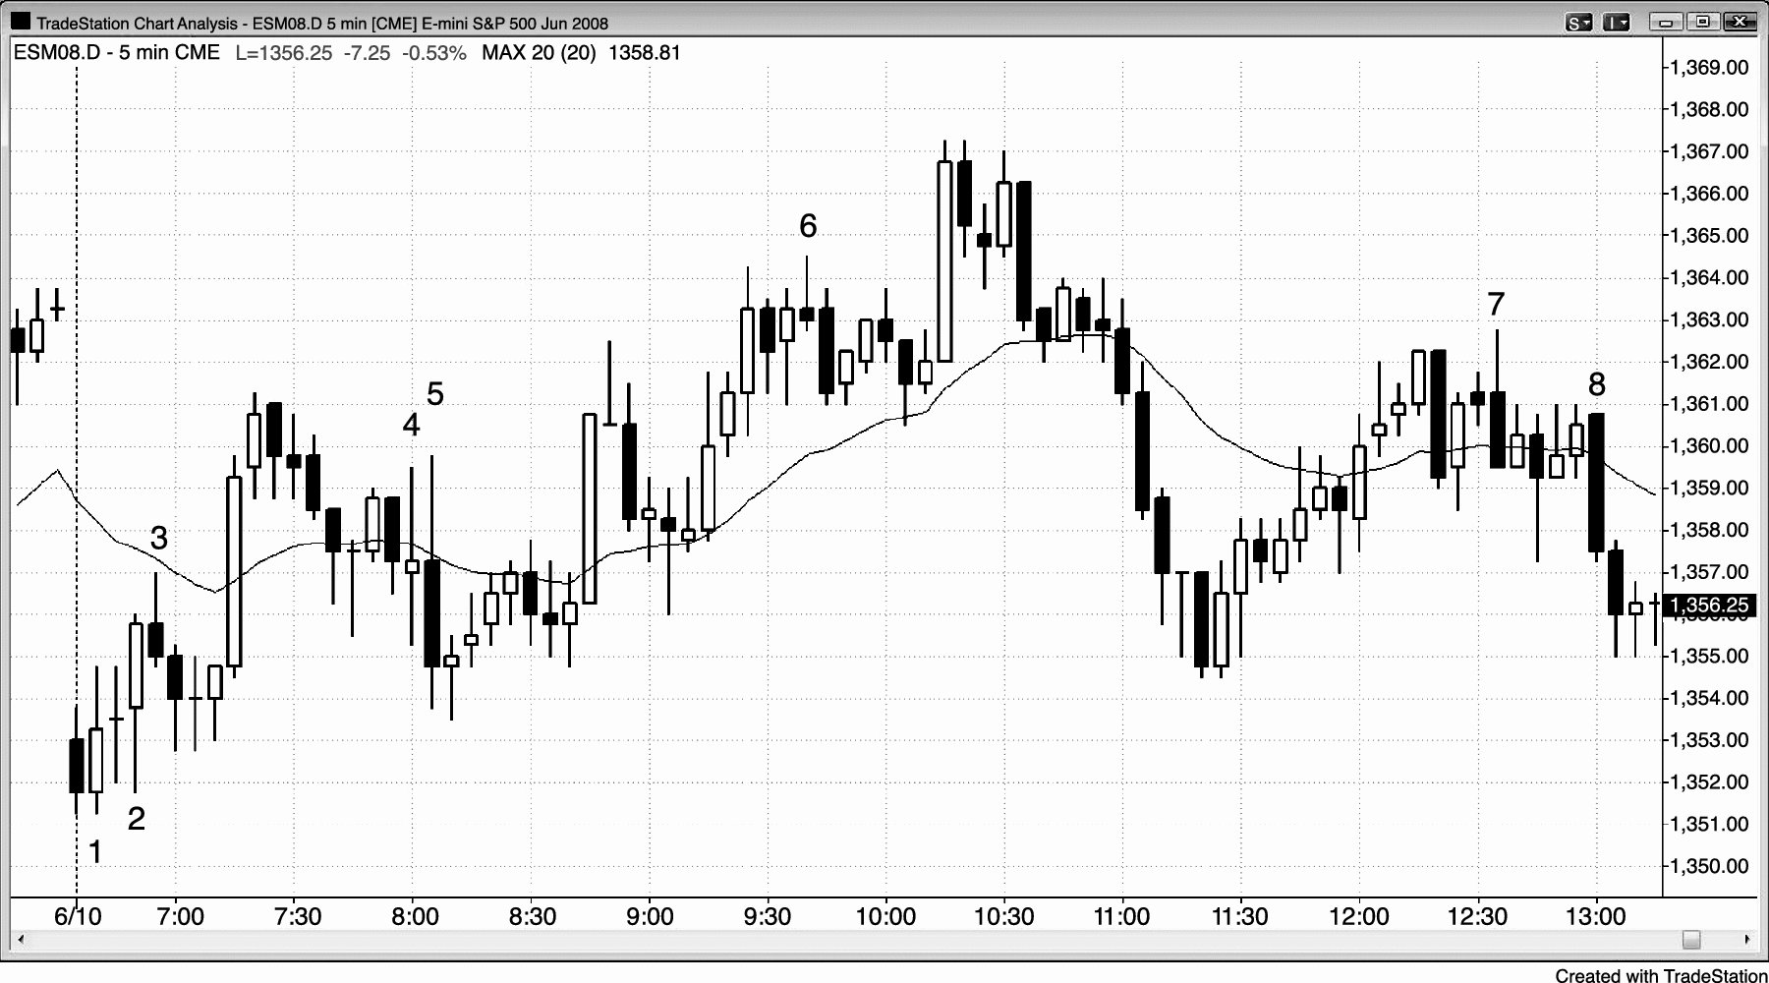
FIGURE 7.3 Outside Bars Depend on Context

Slide 4
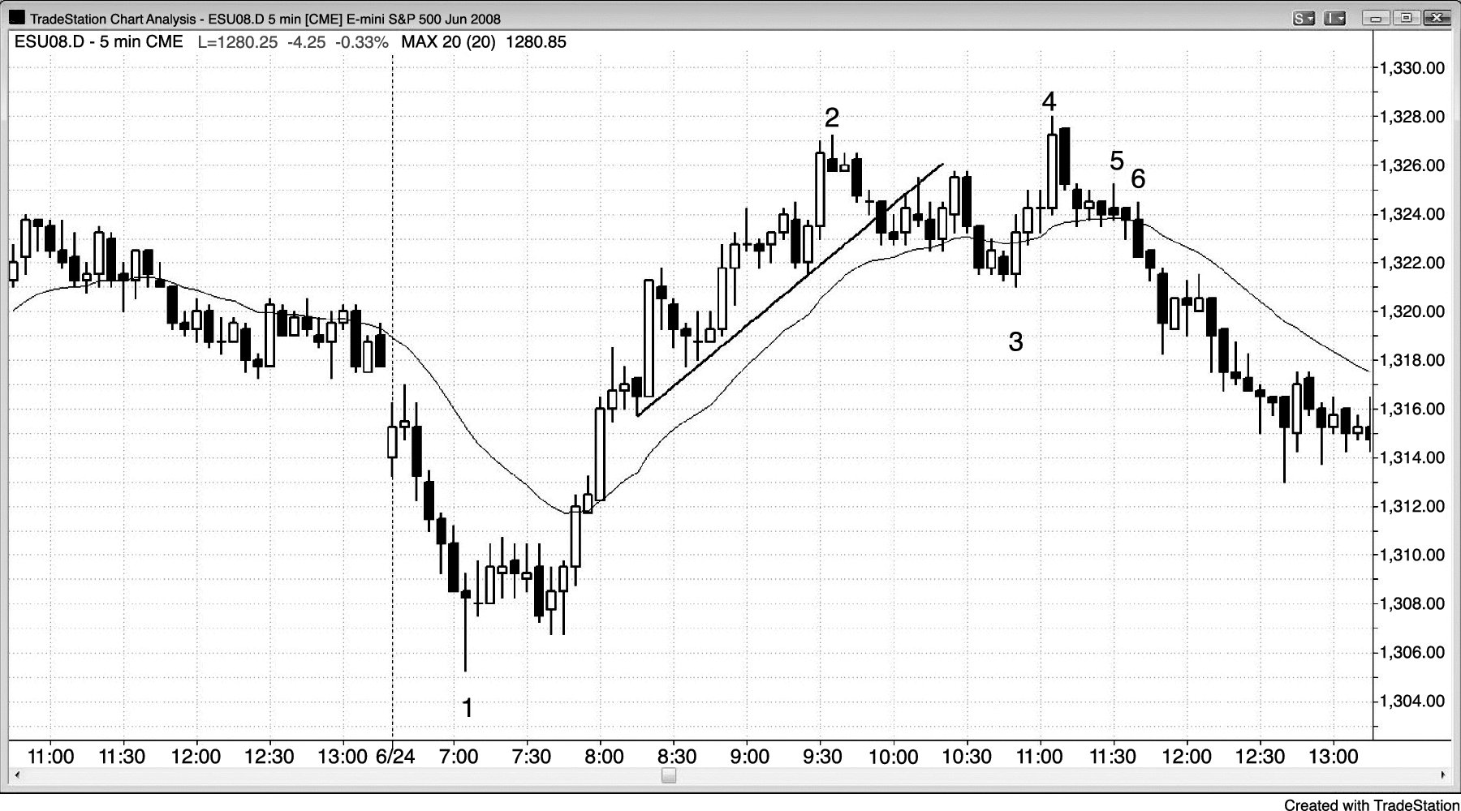
FIGURE 7.4 An Outside Bar as an Entry Bar

